Slide 1
BETA HELIX MEMBRANE PROTEINS

Slide 2
A) UspA 1
MEMBRANE PROTEINS
B) PERTACTIN
C) LRRP

Slide 3
a) PEL C
SUPPLEMENTARY PROTEINS
b) PEL A
c) IBP
e) AFP
d) Cthe 2159

Slide 4
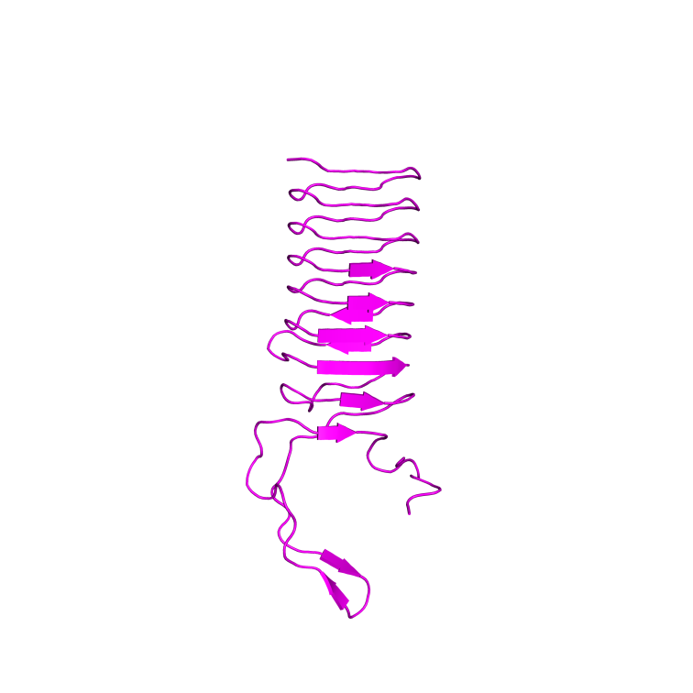
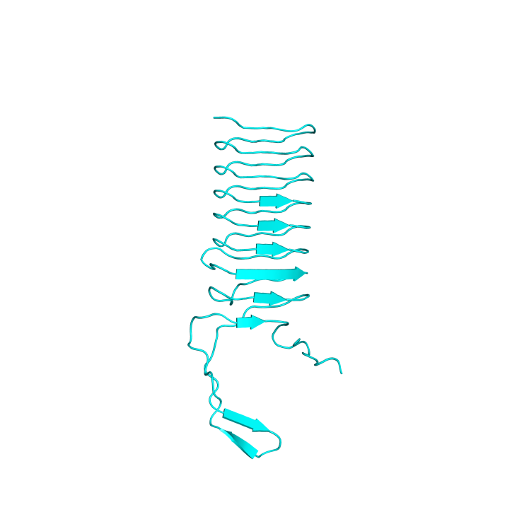
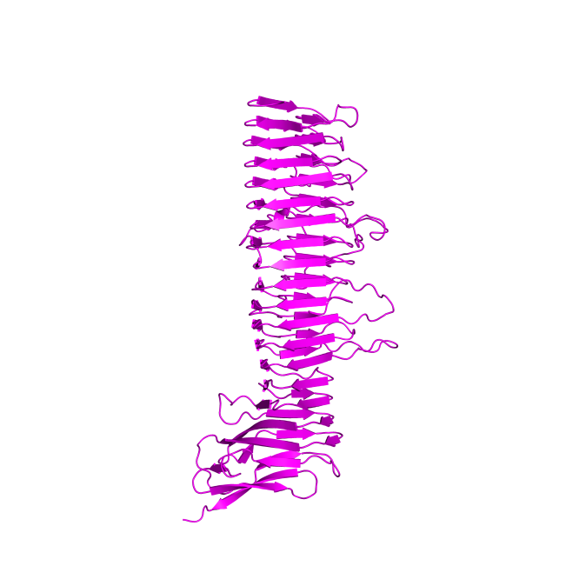
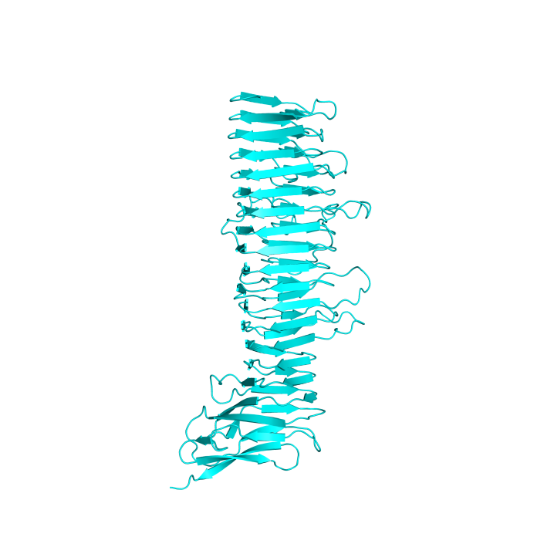
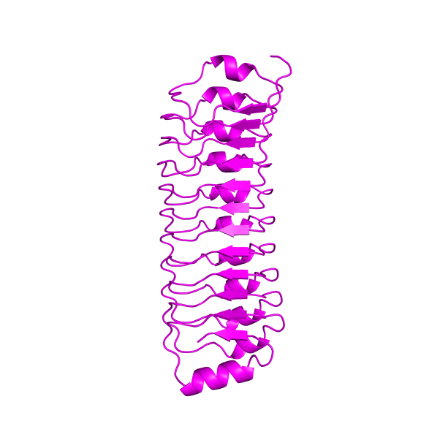
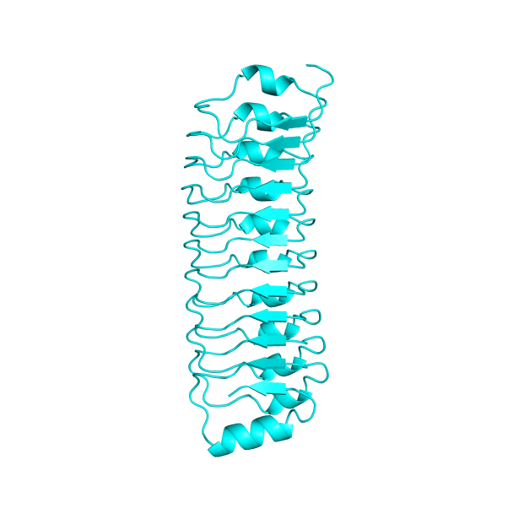
MEMBRANE PROTEINS
a) UspA 1
Native QTY
b) Pertactin
Native QTY
c) LRRP
Native QTY

Slide 5
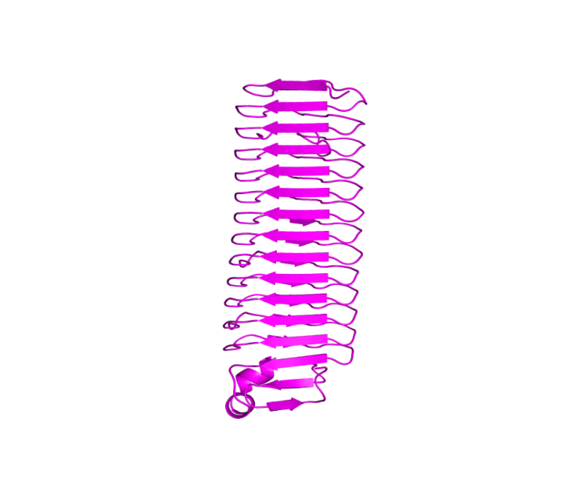
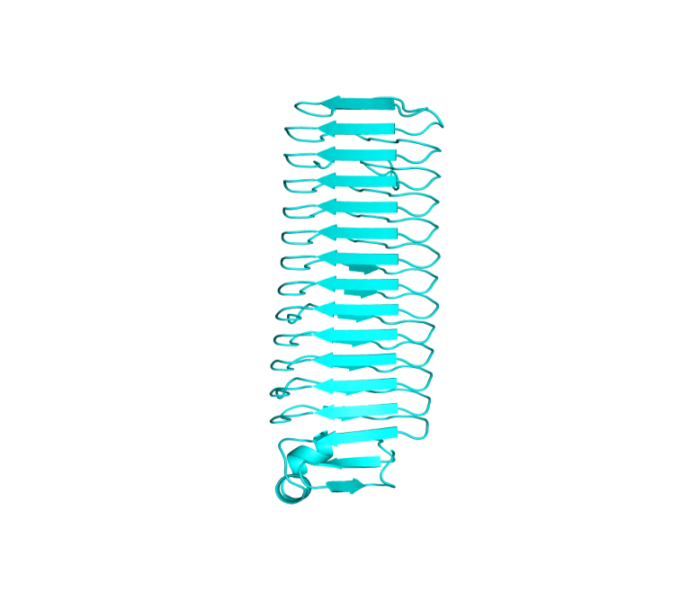
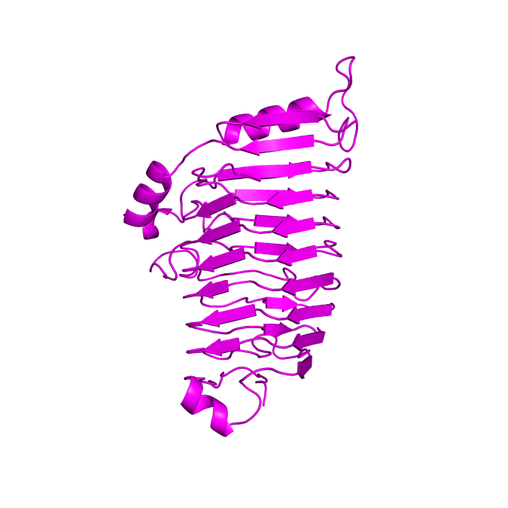
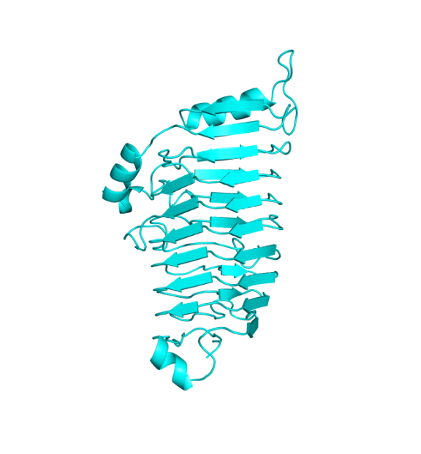
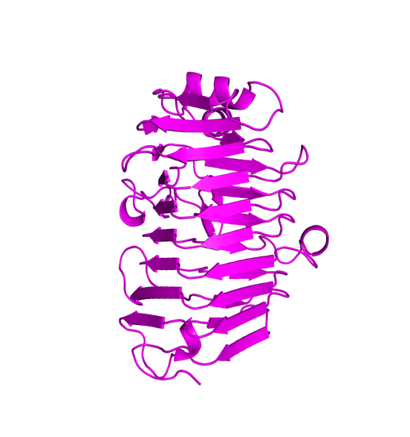
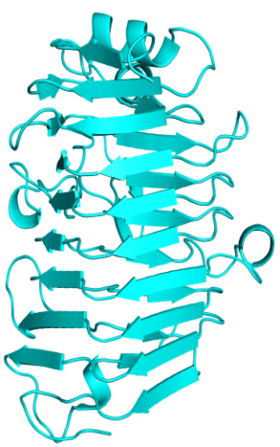
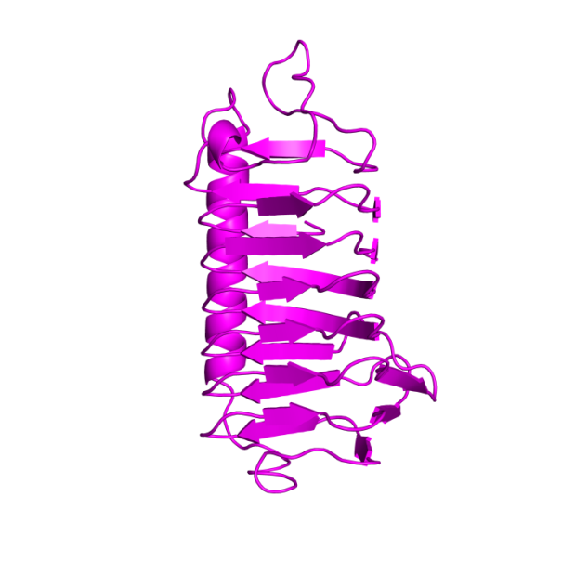
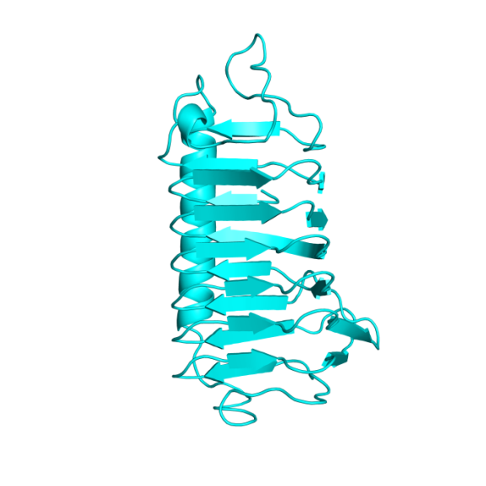
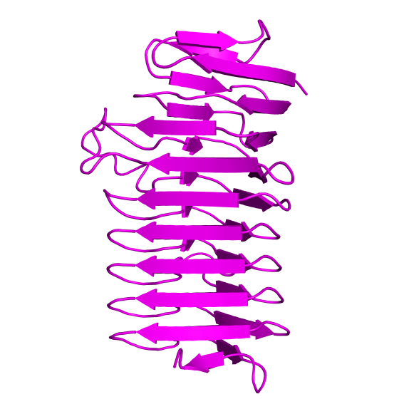
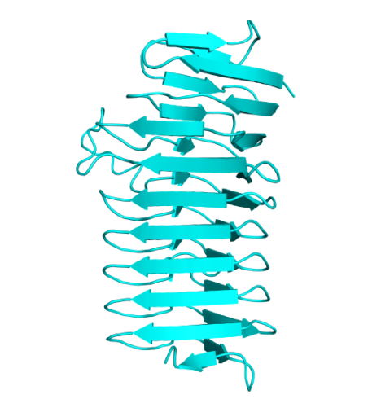
SUPPLEMENTARY PROTEINS
a) AFP
Native QTY
b) PEL C
Native QTY
c) Pel A
Native QTY
d) IBP
^{Native} ^{QTY}
e) Cthe_2159
Native QTY

Slide 6
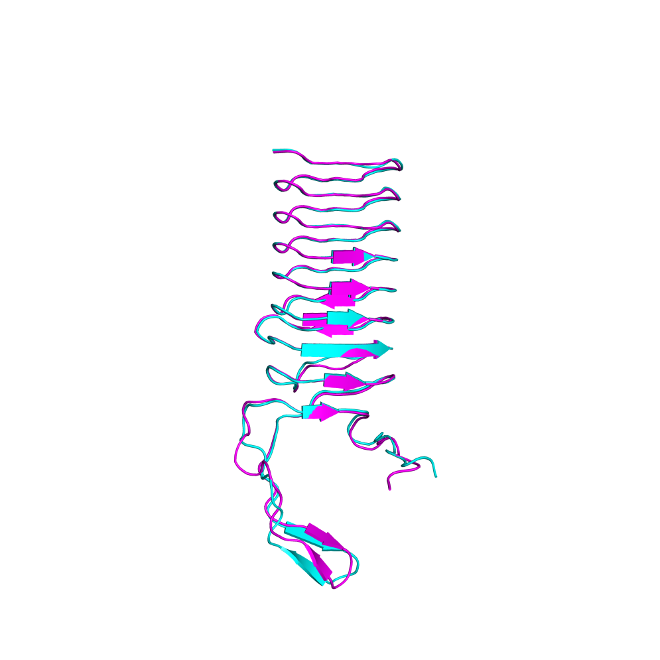
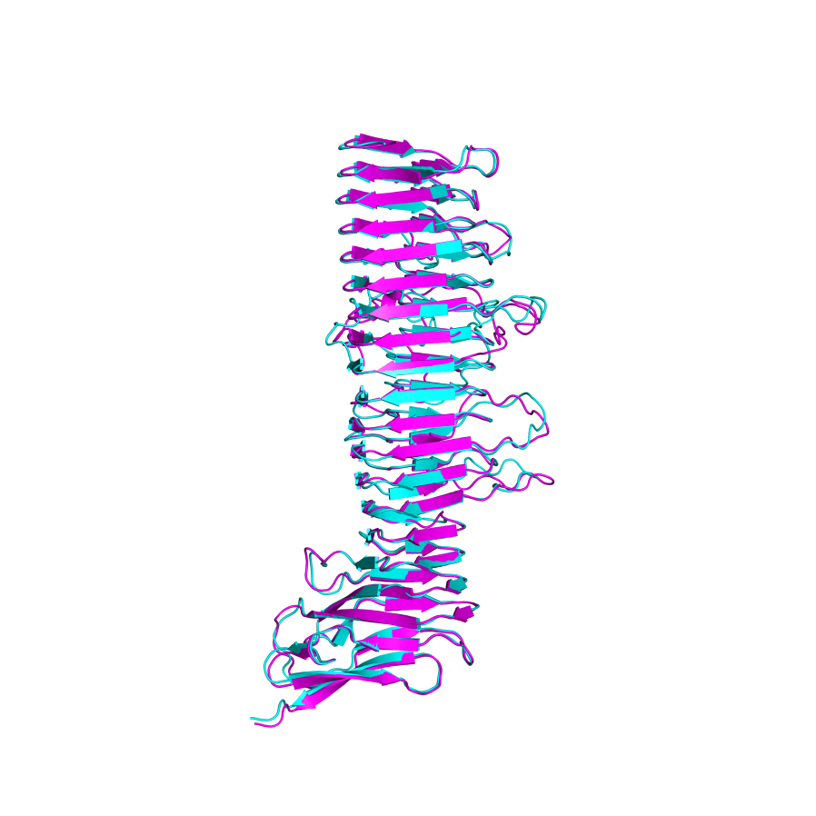
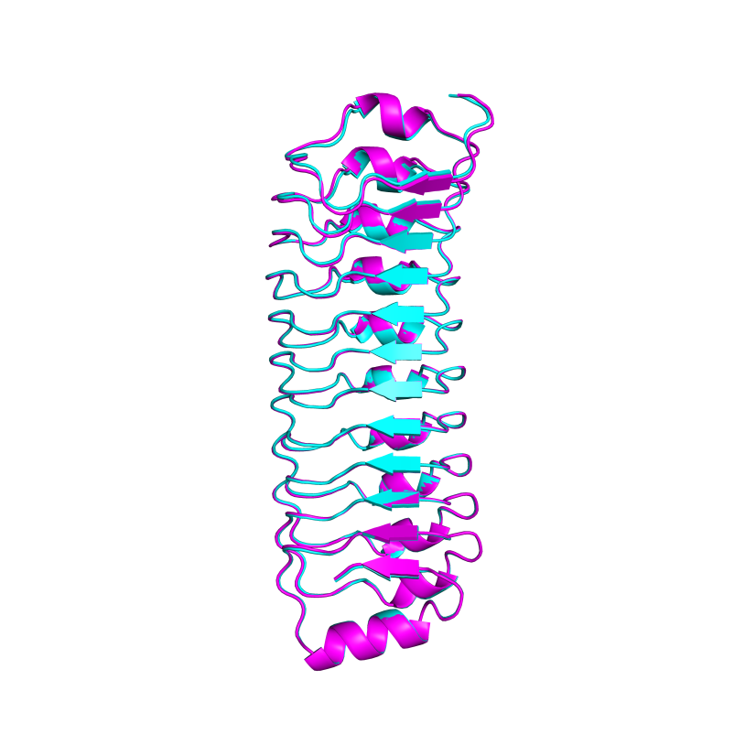
MEMBRANE PROTEINS
a) UspA1 : UspA1^{QTY}
b) Pertactin : Pertactin^{QTY}
c) LRRP : LRRP^{QTY}

Slide 7
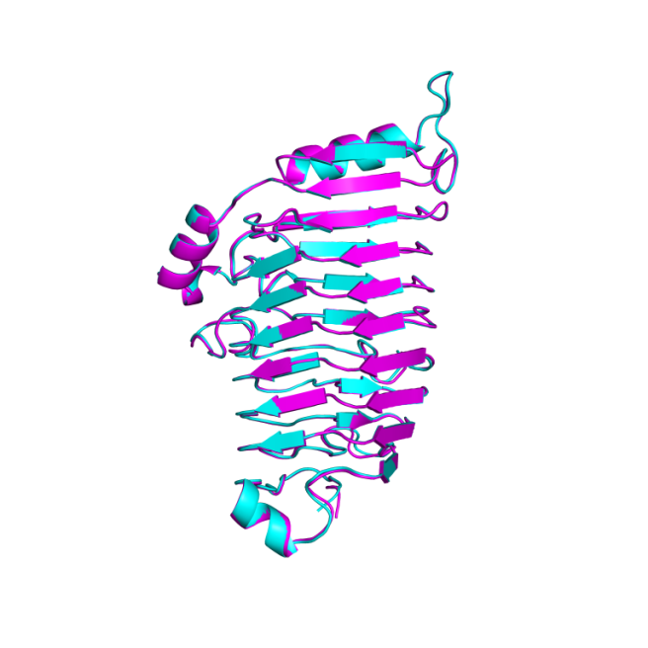
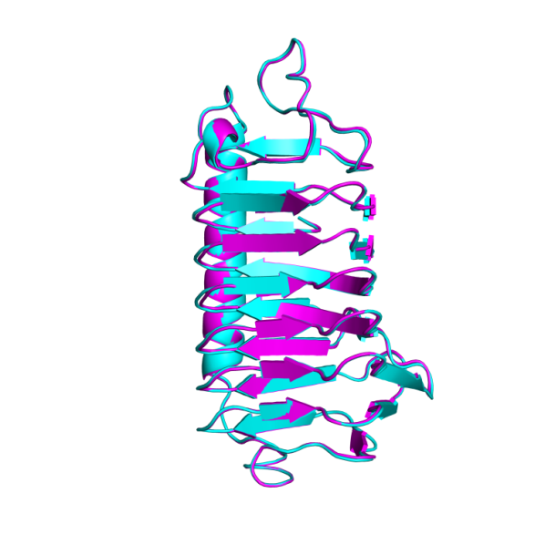
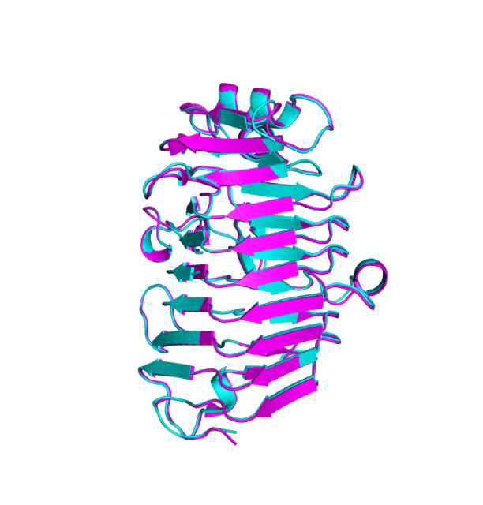
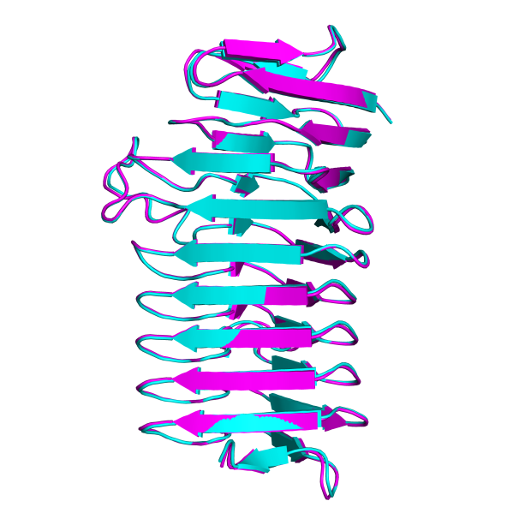
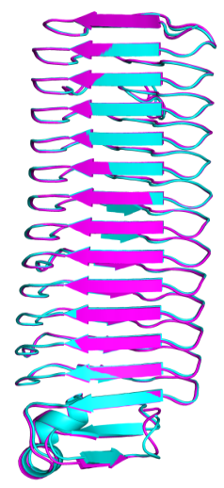
SUPPLEMENTARY PROTEINS
a) PEL C: PEL C^{QTY}
b) PEL A: PEL A^{QTY}
c) IBP: IBP^{QTY}
d) Cthe_2159: Cthe_2159^{QTY}
e) AFP : AFP^{QTY}

Slide 8
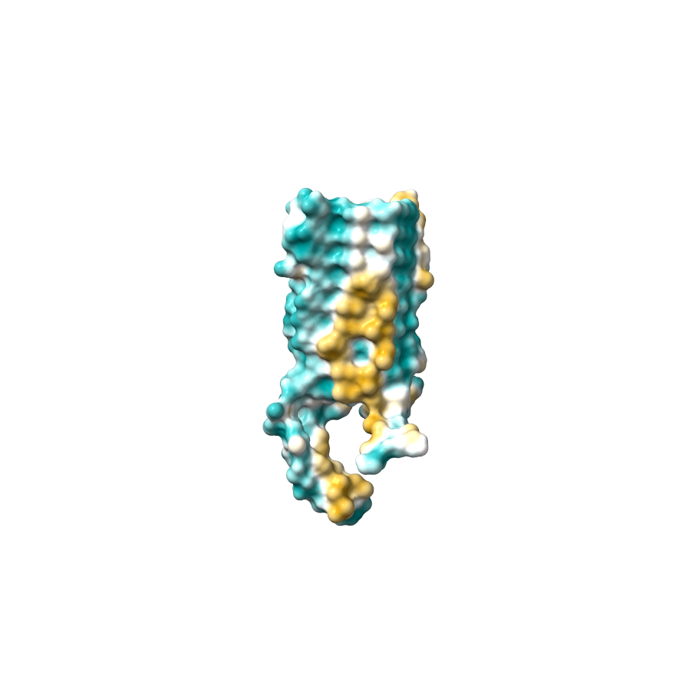
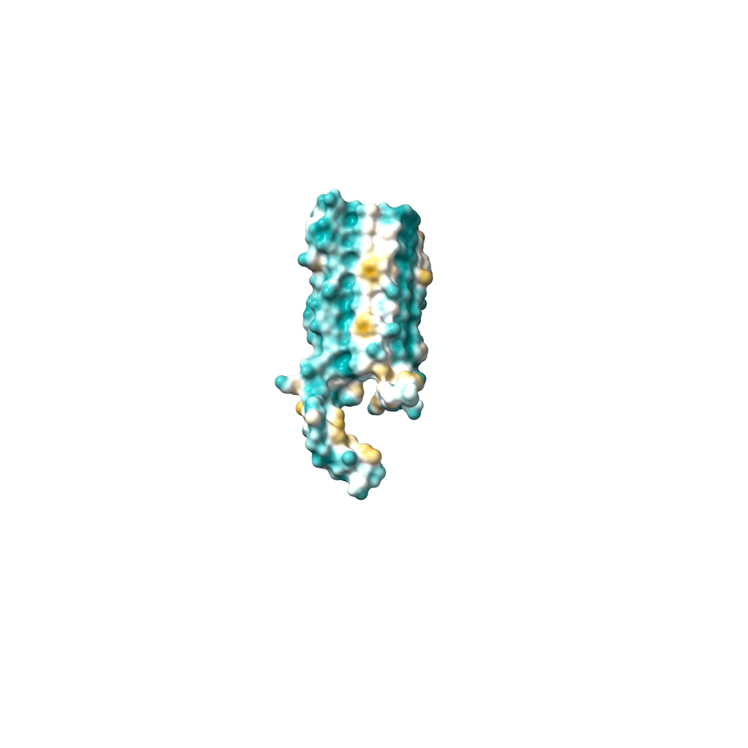
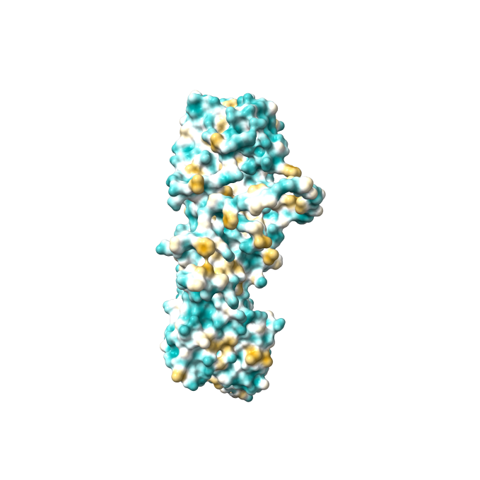
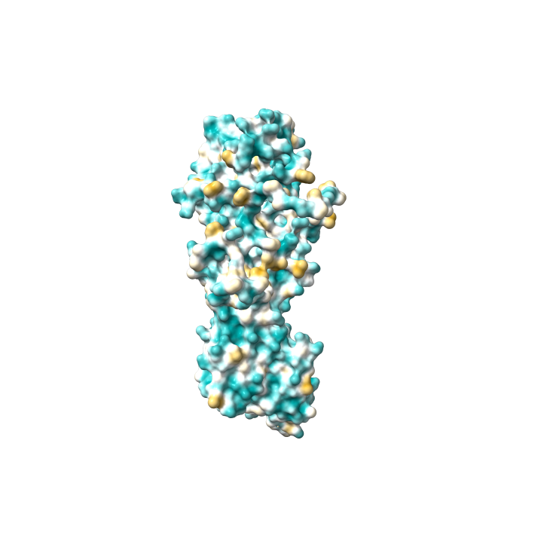
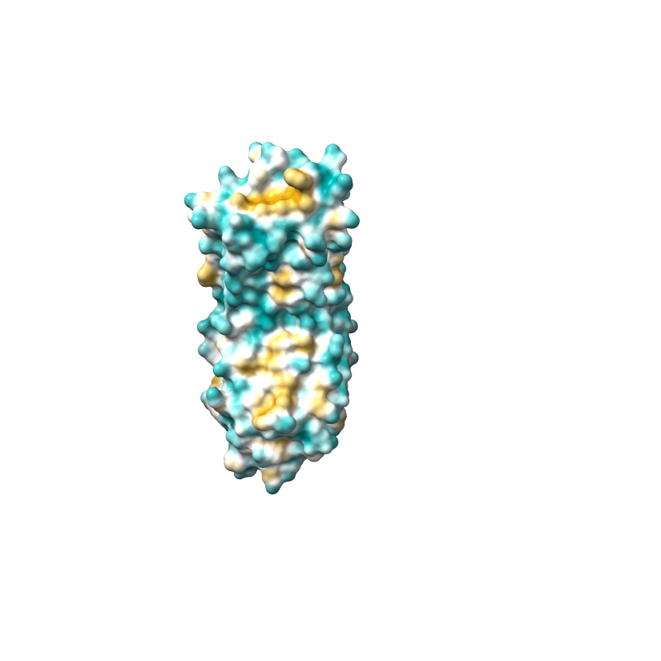
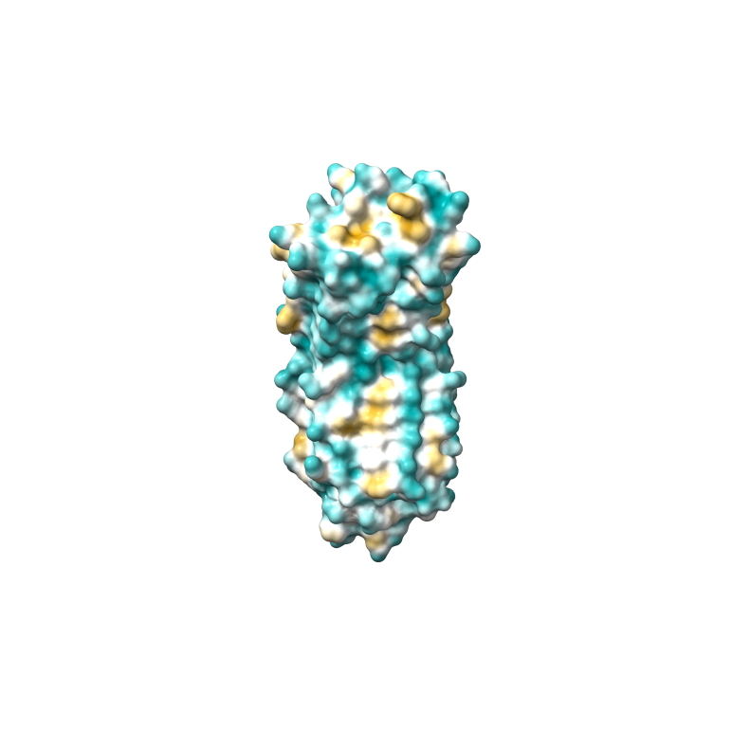
MEMBRANE PROTEINS
a) UspA1
Native QTY
b) Pertactin
Native QTY
c) LRRP
Native QTY

Slide 9
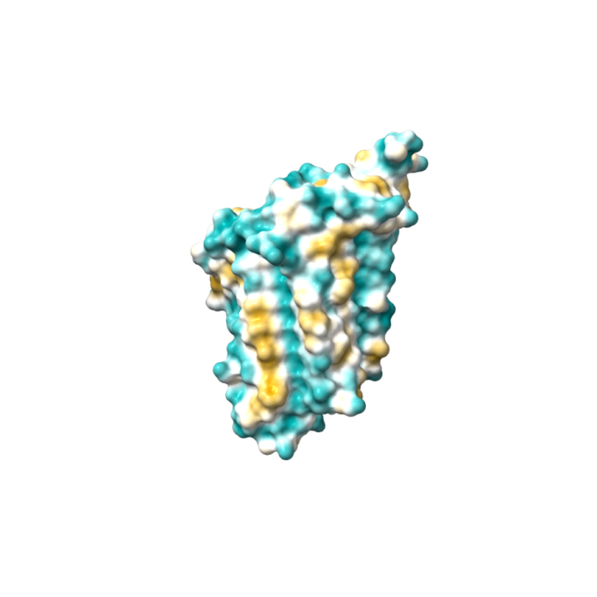
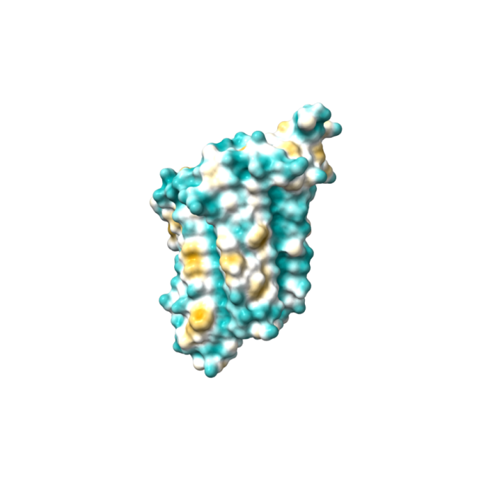
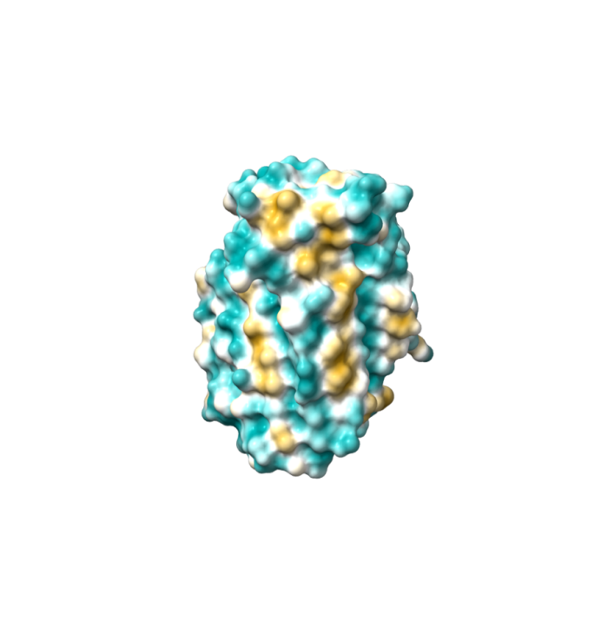
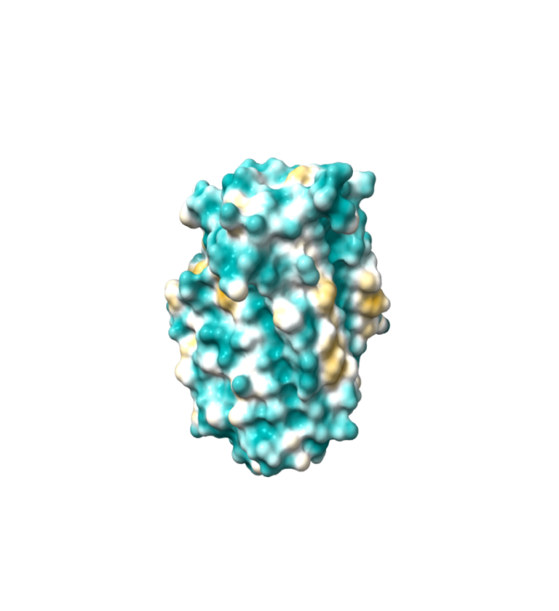
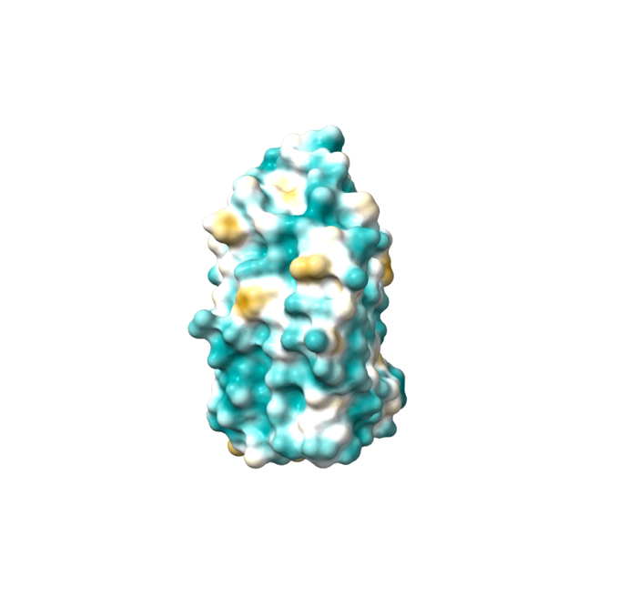
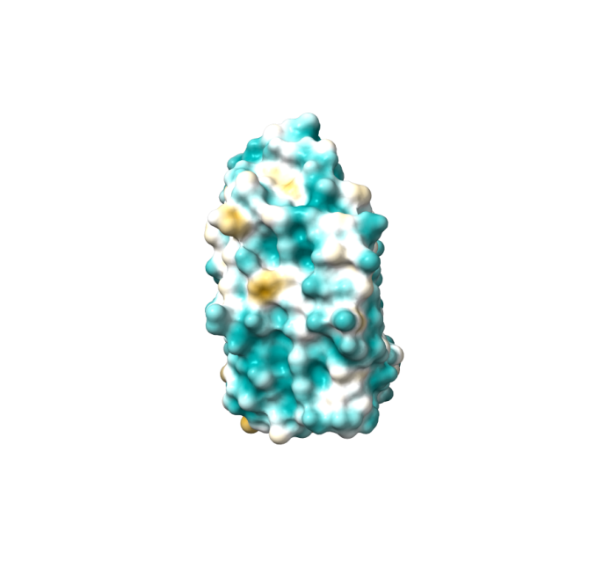
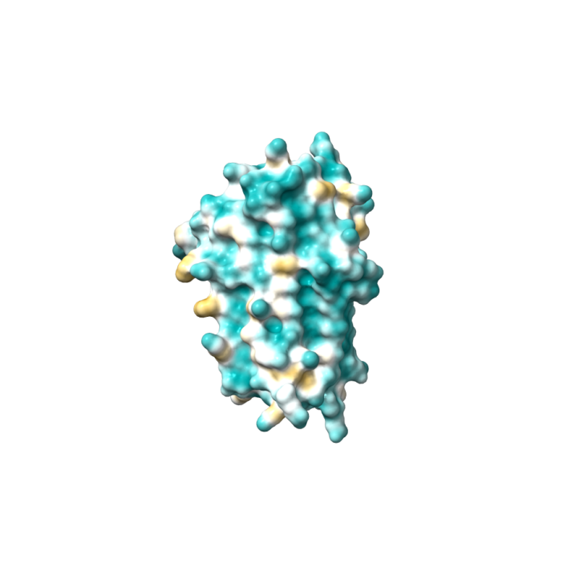
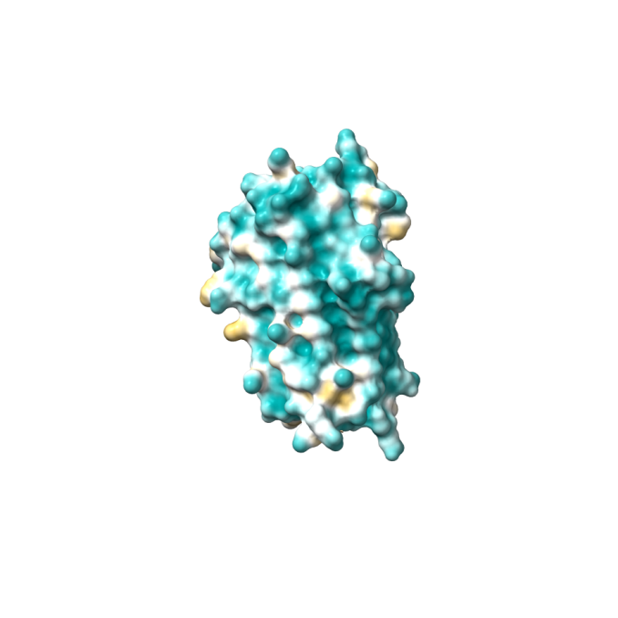
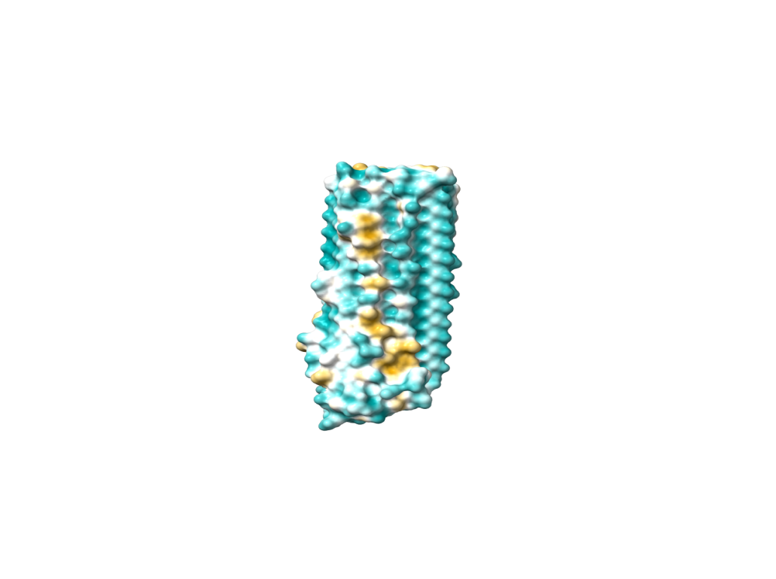
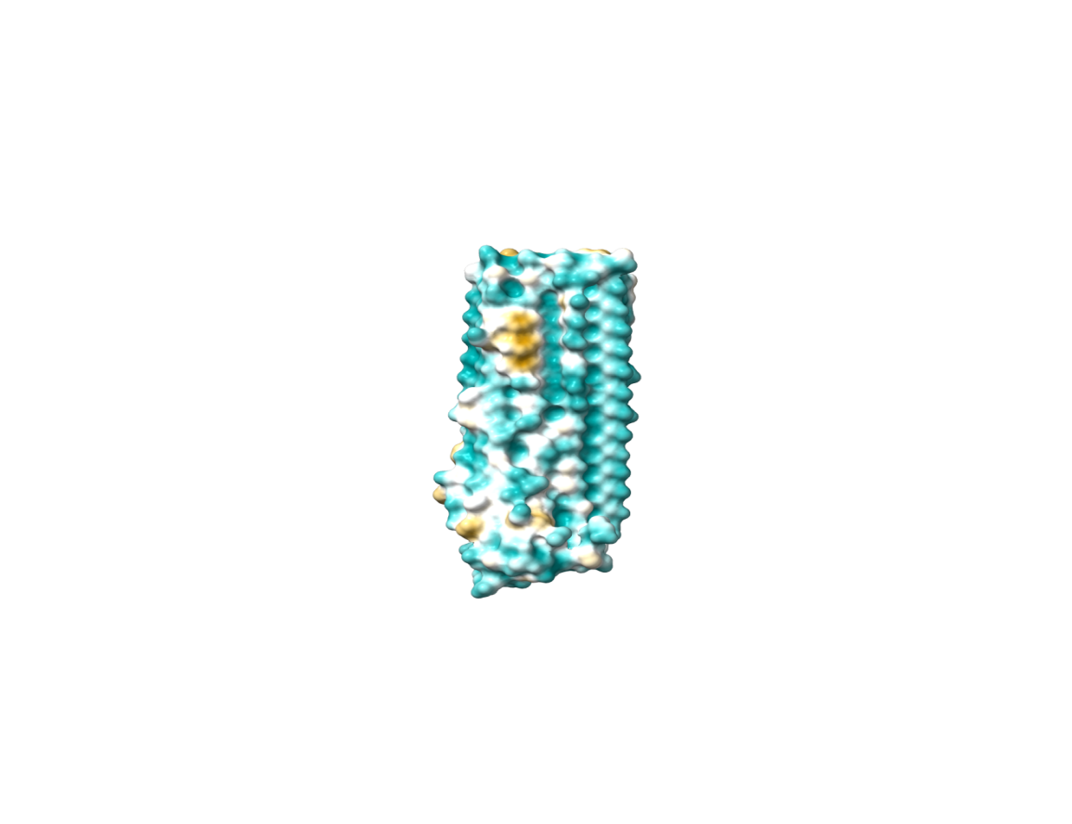
SUPPLEMENTARY PROTEINS
a) PEL C
Native QTY
b) Pel A
Native QTY
c) IBP
Native QTY
d) Cthe_2159
Native QTY
d) AFP
^{Native} ^{QTY}

Slide 10
TABLE 1.1 : CHARACTERISTICS OF BETA-HELIX MEMBRANE PROTEINS
NAME | RMSD | pI | MW (kDa) | Overall variations (%)
UspA1 3NTN | ___ | 9.60 | 15.95 | ___
UspA1^{QTY} | 0.546Å | 9.66 | 15.89 | 12.96% (21/162)
Pertactin 1DAB | ___ | 6.02 | 54.57 | ___
Pertactin^{QTY} | 0.708Å | 6.02 | 55.07 | 19.85% (107/ 539)
LRRP 7YJW | ___ | 6.99 | 30.36 | ___
LRRP^{QTY} | 0.366Å | 6.99 | 30.44 | 10.26% (27/263)

Slide 11
TABLE 1.2 : CHARACTERISTICS OF BETA-HELIX SUPPLEMENTARY PROTEINS
NAME | RMSD | pI | MW (kDa) | Overall variations (%)
PEL C 2PEC | ___ | 6.08 | 31.52 | ___
Pel C^{QTY} | 0.330Å | 6.08 | 31.54 | 15.46% (45/291)
PEL A 1JRG | ___ | 5.28 | 31.75 | ___
Pel A^{QTY} | 0.469Å | 5.28 | 31.71 | 18.15% (53/ 292)
IBP 3UYU | ___ | 4.20 | 21.48 | ___
IBP^{QTY} | 0.367Å | 4.20 | 21.7 | 19.52% (41/210)
Cthe 2159 4PEU | ___ | 4.68 | 26.54 | ___
Cthe 2159^{QTY} | 0.401Å | 4.68 | 26.49 | 22.4% (56/250)
AFP 3P4G | ___ | 3.95 | 30.86 | ___
AFP^{QTY} | 0.488Å | 3.95 | 30.86 | 17.27% (52/301)

Slide 12
Table 2. Characteristics of three Beta-helix proteins and their water-soluble QTY variants.
NAME | RMSD | pI | MW (kDa) | Overall variations (%)
PEL C 2PEC | ___ | 6.08 | 31.52 | ___
Pel C^{QTY} | 0.330Å | 6.08 | 31.54 | 15.46% (45/291)
PEL A 1JRG | ___ | 5.28 | 31.75 | ___
Pel A^{QTY} | 0.469Å | 5.28 | 31.71 | 18.15% (53/ 292)
IBP 3UYU | ___ | 4.20 | 21.48 | ___
IBP^{QTY} | 0.367Å | 4.20 | 21.7 | 19.52% (41/210)
Cthe 2159 4PEU | ___ | 4.68 | 26.54 | ___
Cthe 2159^{QTY} | 0.401Å | 4.68 | 26.49 | 22.4% (56/250)
AFP 3P4G | ___ | 3.95 | 30.86 | ___
AFP^{QTY} | 0.488Å | 3.95 | 30.86 | 17.27% (52/301)

